Slide 1
GRASP-Case Study

Slide 2
Using Design Patterns with GRASP
General Responsibility Assignment Software Patterns
The “patterns” provide a representation of basic principles that form a foundation for designing object- oriented systems.
Creator | Controller | Pure Fabrication
Information Expert | High Cohesion | Low Coupling
1

Slide 3
Example of RDD – Monopoly Game
3

Slide 4
Example of RDD – Monopoly Game
played-with
played-on
2
Die
MonopolyGame
Board
faceValue
1
plays
contains
2..8
40
Player
owns
Piece
Is-on
Square
name
name
0..8
1
name
Domain Model (Analyze Phase)
4

Slide 5
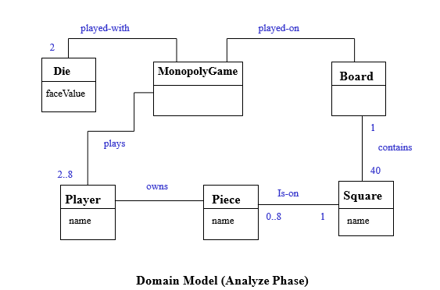
Monopoly Game Example
Who creates the Square object in a Monopoly game?
The Creator pattern
Java answer: Any object could
But what makes for good design?
Common answer: Make Board create Square objects
Intuition: Containers should create the things contained in them
Issue: Wait, but we don’t have any classes yet, we only have the domain model!
We have to start somewhere, and we look at the domain model for inspiration to pick our first few important software classes
5

Slide 6
Implementation of the Creator Pattern in Monoply
Board
40 | Square
 | name
Applying the Creator pattern in Static Model
create
:Board
create
:Square
Dynamic Model – illustrates Creator Pattern
6

Slide 7
Monopoly Game Example
Who knows about a Square object, given a key?
Information Expert pattern
The player Marker needs to find the square to which it is to move and the options pertaining to that square.
The Board aggregates all of the Squares, so the Board has the Information needed to fulfill this responsibility.
7

Slide 8
Make Board Information Expert
By expert
:Board
sqs: Map<Square>
s = getSquare(name)
s =get (name) : Square
8

Slide 9
Alternative Design
Dog: Piece
:Board
Sqs: Map<Square>
s = getSquare(name)
sqs = getAllSquares(name)
Poor Design !
s = get (name) : Square
Piece
Board
Square
squares
getAllSquares
Alternative – Assign getSquare( name) to the Piece object
getSquare
{Map}
More coupling if Piece has getSquare ( )
9

Slide 10
Low Coupling
Key Point: Expert Supports Low Coupling
To return to the motivation for Information Expert: it guides us to a choice that supports Low Coupling. Expert asks us to find the object that has most of the information required for the responsibility (e.g., Board) and assign responsibility there.
If we put the responsibility anywhere else (e.g., Dog), the overall coupling will be higher because more information or objects must be shared away from their original source or home, as the squares in the Map collection had to be shared with the Dog, away from their home in the Board.

Slide 11
Controller
A simple layered architecture has a user interface layer (UI) and a domain layer. Actors, such as the human player in Monopoly, generate UI events (such as clicking a button with a mouse to play a game or make a move). The UI software objects (such as a JFrame window and a JButton) must process the event and cause the game to play. When objects in the UI layer pick up an event, they must delegate the request to an object in the domain layer.
What first object beyond the UI layer should receive the message from the UI layer?
12

Slide 12
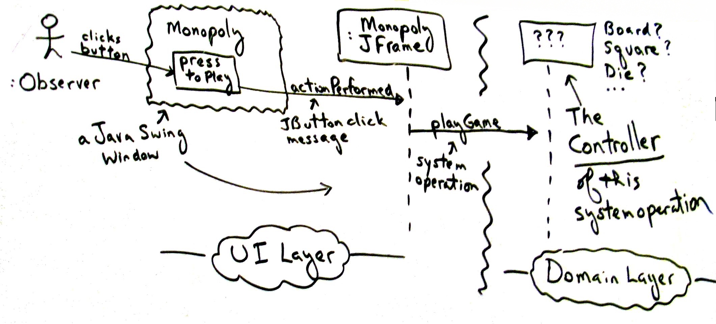

Slide 13
The Controller Pattern
Monopoly: JFrame
:Monopoly Game
JButton
Press to play
actionPerformed
playGame
Domain Layer
UI Layer

Slide 14
Option 1: Represents the overall “system” or a “root object”
An object called MonopolyGame
Option 2: Represents a device that the software is running within
It doesn’t really apply here.
It applies to designs with specialized hardware devices: Phone, BankCashMachine, …
Option 3: Represents the use case or session.
The use case that the playGame system operation occurs in is called Play Monopoly Game
A class such as PlayMonopolyGameHandler (or ...Session) might be used
The very first option looks good if there are only a few system operations

Slide 15
First Iteration of the Monopoly Game
In Iteration 1 – there is no winner. The rules of the game are not yet incorporated into the design. Iteration 1 is merely concerned with the mechanics of having a player move a piece around the Board, landing on one of the 40 Squares each turn.
Definition –
turn – a player rolling the dice and moving one piece round – all players taking one turn
The game loop algorithm:
for N rounds
for each player p
p takes a turn

Slide 16
Assign Responsibility for Controlling the Game Loop
Information Needed | Who Has the Information?
The current round count | No object has it yet, but by LRG*, assigning this to the MonopolyGame object is justifiable
All the players (so that each can be used in taking a turn) | From examination of the domain model, MonopolyGame is a good candidate.
*LRG – low representational gap. and software models.
Lower the gap between our mental

Slide 17
Controlling the Game Loop
:MonopolyGame
playGame
loop [rndCnt < N]
playRound

Slide 18
Who Takes a Turn?
Information Needed | Who Has the Information?
Current location of the player (to know the starting point of a move) | We observe from the domain model, a Piece knows its Square and a Player knows its Piece. Therefore, a Player software object could know its location by LRG.
The two Die objects (to roll them and calculate their total) | The domain model indicates that MonopolyGame is a candidate since we think of the dice as being part of the game.
All the squares – the square organization (to be able to move to the correct new square) | By LRG, Board is a good candidate.

Slide 19
Taking a Turn
Taking a turn means:
Calculating a random number between 2 and 12
Determining the location of the new square
Moving the player’s piece from the old location to the new square.
Calculating a new face value means changing information in Die, so by Expert, Die
should be able to roll itself (generate a random number) and answer its face value.
The new square location problem: Since the Board knows all its Squares, it should be responsible for finding a new square location, given an old square location and some offset (the dice total)
The piece movement problem: By LRG it is reasonable for a Player to know its Piece, and a Piece its Square location (or even for a Player to directly know its Square location). By Expert, a Piece will set its new location, but may receive that new location from its Player.

Slide 20
Final Design of the System Operation playGame (Iter. 1)
:MonopolyGame
players
[i]:Player
playGame
loop
playRound
loop
takeTurn
:Player
dice[i] : Die
:Board
:Piece
takeTurn
roll
fv = getFaceValue
oldLoc = getLocation( ):Square
newLoc = getSquare(oldLoc, fvTot) : Square setLocation (newLoc)
21

Slide 21
Pure Fabrication
Pure Fabrication
What object should have responsibilitywhen you do not want to violate High Cohesion and Low Coupling, or other goals, but solutions offered by Expert (for example) are not appropriate?
Sometimes assigning responsibilities only to domain
layer software classes leads to problems like poor cohesion or coupling, or low reuse potential.
Name: Problem:
Solution:
Assign a highly cohesive set of responsibilities to an artificial or convenience class that does not represent a
domain concept.
Example: Rolling the dice in a Monopoly game – Dice are used in many games
and putting the rolling and summing responsibilities in Player makes it impossible to generalize this service. Also, it is not now possible to simply ask for
the current dice total without rolling again.
33

Slide 22
Pure Fabrication
Use a Cup to hold the dice, roll them, and know their total. It can be reused in many different applications where dice are involved.
p:Player
:Cup
:Board
loc:Square
takeTurn
roll
fvTot = getTotal
loc = getSquare(lo
c, fvTot)
landedOn(p)
34

